Slide 1
Distributed Computing Paradigms

Slide 2
Paradigms for Distributed Applications
Paradigm means “a pattern, example, or model.” In the study of any subject of great complexity, it is useful to identify the basic patterns or models and classify the detail according to these models. This paper aims to present a classification of the paradigms for distributed applications.
Characteristics that distinguish distributed applications from conventional applications which run on a single machine. These characteristics are
Interprocess communication: A distributed application require the participation of two or more independent entities (processes). To do so, the processes must have the ability to exchange data among themselves.
Event synchronization: In a distributed application, the sending and receiving of data among the participants of a distributed application must be synchronized.

Slide 3
Abstractions
Arguably the most fundamental concept in computer science, abstraction is the idea of detail hiding. To quote David J. Barnes1:
We often use abstraction when it is not necessary to know the exact details of how something works or is represented, because we can still make use of it in its simplified form. Getting involved with the detail often tends to obscure what we are trying to understand, rather than illuminate it …Abstraction plays a very important role in programming because we often want to model, in software, simplified versions of things that exist in the real world … without having to build the real things
In software engineering, abstraction is realized with the provision of tools or facilities which allow software to be built without the developer having to be cognizant of some of the underlying complexities.

Slide 4
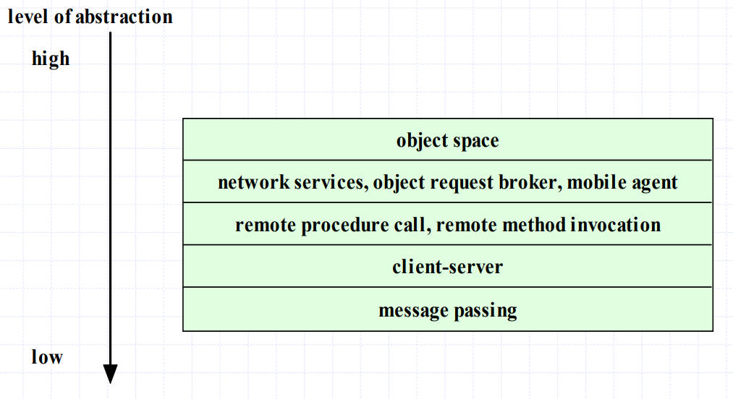
Distributed Application Paradigms

Slide 5
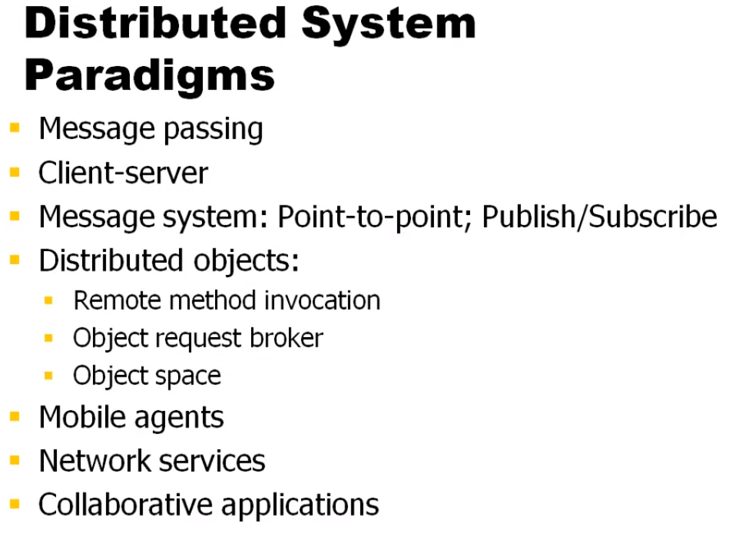
Distributed Computing Paradigm

Slide 6
The Message Passing Paradigm
Message passing is the most fundamental paradigm for distributed applications.
A process sends a message representing a request.
The message is delivered to a receiver, which processes the request, and sends a message in response.
In turn, the reply may trigger a further request, which leads to a subsequent reply, and so forth.

Slide 7
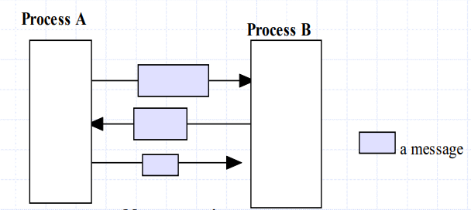

The Message Passing Paradigm - 2
Message Passing

Slide 8
The Message Passing Paradigm - 3
The basic operations required to support the basic message passing paradigm are send and receive.
For connection-oriented communication, the operations connect and disconnect are also required.
With the abstraction provided by this model, the interconnected processes perform input and output to each other, in a manner similar to file I/O. The I/O operations encapsulate the detail of network communication at the operating-system level.
The socket application programming interface is based on this paradigm.
http://java.sun.com/products/jdk/1.2/docs/api/index.html
http://www.sockets.com

Slide 9
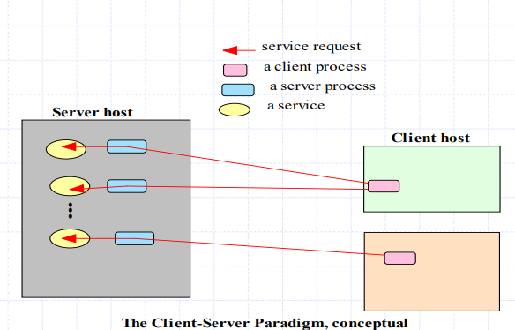
The Client-Server Paradigm
Perhaps the best-known paradigm for network applications, the client-server2 model assigns asymmetric roles to two collaborating processes.
One process, the server, plays the role of a service provider which waits passively for the arrival of requests. The other, the client, issues specific requests to the server and awaits its response.

Slide 10
The Client-Server Paradigm - 2
Simple in concept, the client-server model provides an efficient abstraction for the delivery of network services.
Operations required include those for a server process to listen and to accept requests, and for a client process to issue requests and accept responses.
By assigning asymmetric roles to the two sides, event synchronization is simplified: the server process waits for requests, and the client in turn waits for responses.
Many Internet services are client-server applications. These services are often known by the protocol that the application implements. Well known Internet services include HTTP, FTP, DNS, finger, gopher, etc.

Slide 11
The Peer-to-Peer System Architecture
In system architecture and networks, peer-to-peer is an architecture where computer resources and services are direct exchanged between computer systems.
These resources and services include the exchange of information, processing cycles, cache storage, and disk storage for files..
In such an architecture, computers that have traditionally been used solely as clients communicate directly among themselves and can act as both clients and servers, assuming whatever role is most efficient for the network.

Slide 12
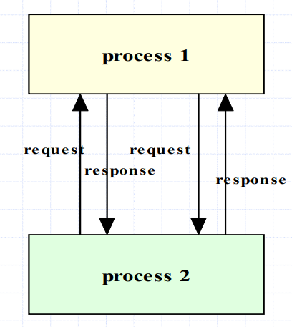
The Peer-to-Peer Distributed Computing Paradigm
In the peer-to-peer paradigm, the participating processes play equal roles, with equivalent capabilities and responsibilities (hence the term “peer”). Each participant may issue a request to another participant and receive a response.

Slide 13
Peer-to-Peer distributed computing
Whereas the client-server paradigm is an ideal model for a centralized network service, the peer-to-peer paradigm is more appropriate for applications such as instant messaging, peer-to-peer file transfers, video conferencing, and collaborative work. It is also possible for an application to be based on both the client-server model and the peer-to-peer model.
A well-known example of a peer-to-peer file transfer service is Napster.com or similar sites which allow files (primarily audio files) to be transmitted among computers on the Internet. It makes use of a server for directory in addition to the peer-to-peer computing.

Slide 14
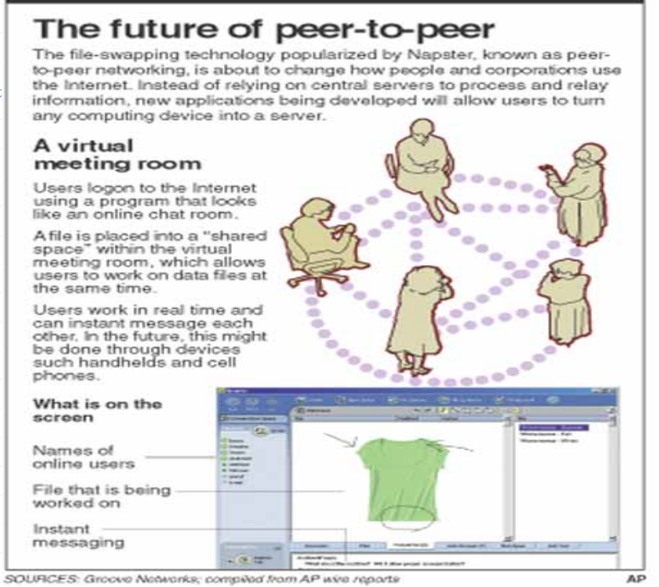





Slide 15
Peer-to-Peer distributed computing
The peer-to-peer paradigm can be implemented with facilities using any tool that provide message-passing, or with a higher-level tool such as one that supports the point-to-point model of the Message System paradigm.
For web applications, the web agent is a protocol promoted by the XNSORG (the XNS Public Trust Organization) for peer-to-peer interprocess communication
“Project JXTA is a set of open, generalized peer-to-peer protocols that allow any connected device (cell phone, to PDA, PC to server) on the network to communicate and collaborate. JXTA is short for Juxtapose, as in side by side.
It is a recognition that peer to peer is juxtapose to client server or Web based computing -- what is considered today's traditional computing model.

Slide 16
The Message System Paradigm
The Message System or Message-Oriented Middleware (MOM) paradigm is an elaboration of the basic message-passing paradigm.
In this paradigm, a message system serves as an intermediary among separate, independent processes.
The message system acts as a switch for messages, through which processes exchange messages asynchronously, in a decoupled manner.
A sender deposits a message with the message system, which forwards it to a message queue associated with each receiver. Once a message is sent, the sender is free to move on to other tasks.

Slide 17
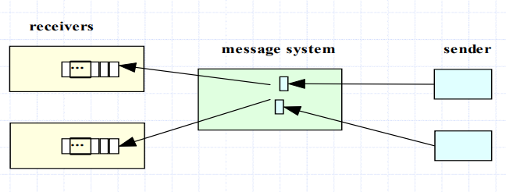
The Message System Paradigm

Slide 18
Two subtypes of message system models
The Point-To-Point Message Model
In this model, a message system forwards a message from the sender to the receiver’s message queue. Unlike the basic message passing model, the middleware provides a message depository, and allows the sending and the receiving to be decoupled. Via the middleware, a sender deposits a message in the message queue of the receiving process. A receiving process extracts the messages from its message queue and handles each one accordingly.
Compared to the basic message-passing model, this paradigm provides the additional abstraction for asynchronous operations. To achieve the same effect with basic message-passing, a developer will have to make use of threads or child processes.

Slide 19
The Publish/Subscribe Message Model
In this model, each message is associated with a specific topic or event. Applications interested in the occurrence of a specific event may subscribe to messages for that event. When the awaited event occurs, the process publishes a message announcing the event or topic. The middleware message system distributes the message to all its subscribers.
The publish/subscribe message model offers a powerful abstraction for multicasting or group communication. The publish operation allows a process to multicast to a group of processes, and the subscribe operation allows a process to listen for such multicast.

Slide 20
Toolkits based on the Message- System Paradigm
The MOM paradigm has had a long history in distributed applications.
Message Queue Services (MQS) have been in use since the 1980’s.
The IBM MQ*Series6 is an example of such a facility.
http://www-4.ibm.com/software/ts/mqseries/
Other existing support for this paradigm are
Microsoft’s Message Queue (MSQ),
http://msdn.microsoft.com/library/psdk/msmq/msmq_overview_4ilh.htm
Java’s Message Service
http://developer.java.sun.com/developer/technicalArticles/Networking/messaging

Slide 21
Remote Procedure Call
As applications grew increasingly complex, it became desirable to have a paradigm which allows distributed software to be programmed in a manner like conventional applications which run on a single processor.
The Remote Procedure Call (RPC) model provides such an abstraction. Using this model, interprocess communications proceed as procedure, or function, calls, which are familiar to application programmer.
A remote procedure call involves two independent processes, which may reside on separate machines. A process, A, wishing to make a request to another process, B, issues a procedure call to B, passing with the call a list of argument values. As in the case of local procedure calls, a remote procedure call triggers a predefined action in a procedure provided by process B. At the completion of the procedure, process B returns a value to process A.

Slide 22
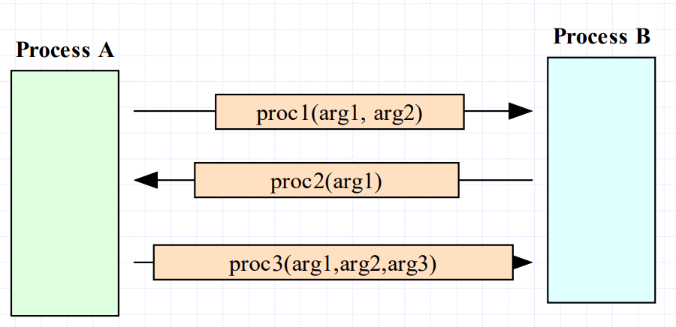
Remote Procedure Call - 2

Slide 23
Remote Procedure Call - 3
RPC allows programmers to build network applications using a programming construct like the local procedure call, providing a convenient abstraction for both inter-process communication and event synchronization.
Since its introduction in the early 1980s, the Remote Procedure Call model has been widely in use in network applications.
There are two prevalent APIs for Remote Procedure Calls.
The Open Network Computing Remote Procedure Call, evolved from the RPC API originated from Sun Microsystems in the early 1980s.
The Open Group Distributed Computing Environment (DCE) RPC.
Both APIs provide a tool, rpcgen, for transforming remote procedure calls to local procedure calls to the stub.

Slide 24
The Distributed Objects Paradigms
The idea of applying object orientation to distributed applications is a natural extension of object-oriented software development.
Applications access objects distributed over a network.
Objects provide methods, through the invocation of which an application obtains access to services.
Object-oriented paradigms include:
Remote method invocation (RMI)
Network services
Object request broker
Object spaces

Slide 25
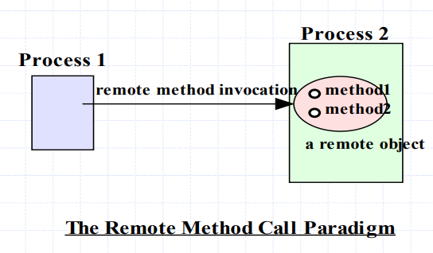
Remote Method Invocation (RMI)
Remote method invocation is the object-oriented equivalent of remote method calls.
In this model, a process invokes the methods in an object, which may reside in a remote host.
As with RPC, arguments
may be passed with the
invocation.

Slide 26
The Network Services Paradigm
In this paradigm, service providers register themselves with directory servers on a network. A process desiring a particular service contacts the directory server at run time, and, if the service is available, will be provided a reference to the service. Using the reference, the process interacts with the service.
This paradigm is essentially an extension of the remote method call paradigm. The difference is that service objects are registered with a global directory service, allowing them to be look up and accessed by service requestors on a federated network.
Java’s Jini12 technology is based on this paradigm.

Slide 27
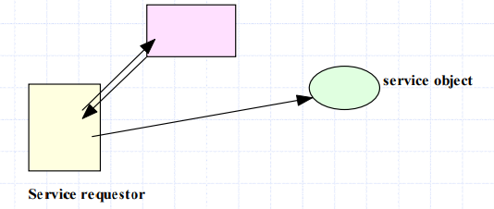
The Network Services Paradigm
Directory Service

Slide 28
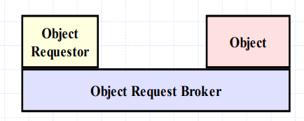
The Object Request broker Paradigm
In the object broker paradigm , an application issues requests to an object request broker (ORB), which directs the request to an appropriate object that provides the desired service.
The paradigm closely resembles the remote method invocation model in its support for remote object access. The difference is that the object request broker in this paradigm functions as a middleware which allows an application, as an object requestor, to potentially access multiple remote (or local) objects.
The request broker may also function as a mediator for heterogeneous objects, allowing interactions among objects implemented using different APIs and /or running on different platforms.

Slide 29
The Object Request broker Paradigm - 2
This paradigm is the basis of the Object Management Group’s CORBA (Common Object Request Broker Architecture) architecture.
http://www.corba.org/
Tool kits based on the architecture include:
Inprise’s Visibroker http://www.inprise.com/visibroker/
Java’s Interface Development Language (Java IDL) http://java.sun.com/products/jdk/idl/
Orbix’s IONA, and TAO from the Object Computing, Inc. http://www.corba.org/vendors/pages/iona.html

Slide 30
The Object Space Paradigm
Perhaps the most abstract of the object-oriented paradigms, the object space paradigm assumes the existence of logical entities known as object spaces.
The participants of an application converge in a common object space.
A provider places objects as entries into an object space, and requesters who subscribe to the space access the entries.

Slide 31
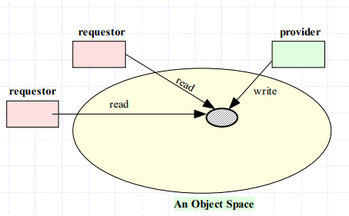
The Object Space Paradigm

Slide 32
The Object Space Paradigm - 2
In addition to the abstractions provided by other paradigms, the object space paradigm provides a virtual space or meeting room among provides and requesters of network resources or objects. This abstraction hides the detail involved in resource or object lookup needed in paradigms such as remote method invocation, object request broker, or network services.
Current facilities based on this paradigm include JavaSpaces
http://java.sun.com/products/javaspaces/

Slide 33
Component-based Technologies
Component-based technologies such as Microsoft’s COM, Microsoft DCOM, Java Bean, and Enterprise Java Bean are also based on distributed-object paradigms, as components are essentially specialized, packaged objects designed to interact with each other through standardized interfaces.
In addition, application servers, popular for enterprise applications, are middleware facilities which provide access to objects or components.
IBM’s WebSphere,
http://www.as400.ibm.com/products/websphere/docs/as400v35/docs/admover.html

Slide 34
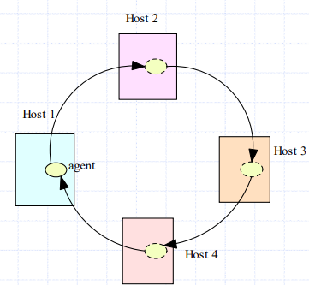
The Mobile Agent Paradigm
A mobile agent is a transportable program or object.
In this model, an agent is launched from an originating host.
The agent travels from host to host according to an itinerary that it carries.
At each stop, the agent accesses the necessary resources or services, and performs the necessary tasks to accomplish its mission.

Slide 35
The Mobile Agent Paradigm - 2
The paradigm offers the abstraction for a transportable program or object.
In lieu of message exchanges, data is carried by the program/object as the program is transported among the participants.
Commercial packages which support the mobile agent paradigm include:
Mitsubishi Electric ITA’s Concordia system
http://www.meitca.com/HSL/Projects/Concordia/Welcome.html
IBM’s Aglet system.
http://www.trl.ibm.co.jp/aglets/

Slide 36
The Collaborative Application (Groupware) Paradigm
In this model, processes participate in a collaborative session as a group. Each participating process may contribute input to part or all of the group.
Processes may do so using:
multicasting to send data to all or part of the group, or they may use a
virtual sketchpads or whiteboards which allows each participant to read and write data to a shared display

Slide 37
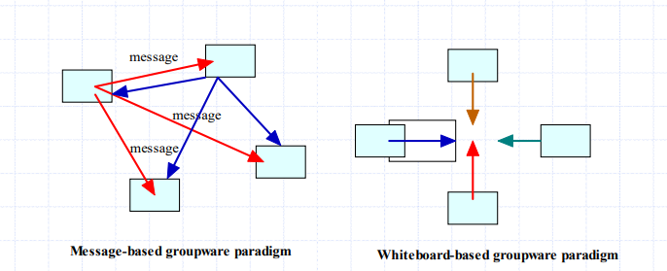
The Collaborative Application (Groupware) Paradigm

Slide 38
Summary - 1
We have looked at a wide range of paradigms for distributed applications.
The paradigms presented were:
Message passing
Client-server
Message system: Point-to-point; Publish/Subscribe
Distributed objects:
Remote method invocation
Object request broker
Object space
Mobile agents
Network services
Collaborative applications

Slide 39
Summary - 2
To varying degrees, these paradigm provide abstractions that insulate the developers from the detail of interprocess communication and event synchronization, allowing the programmer to concentrate on the bigger picture of the application itself.
In choosing a paradigm or a tool for an application, there are tradeoffs that should be considered, including overheads, scalability, cross-platform support, and software engineering issue

Slide 40
Thank you

